Slide 1


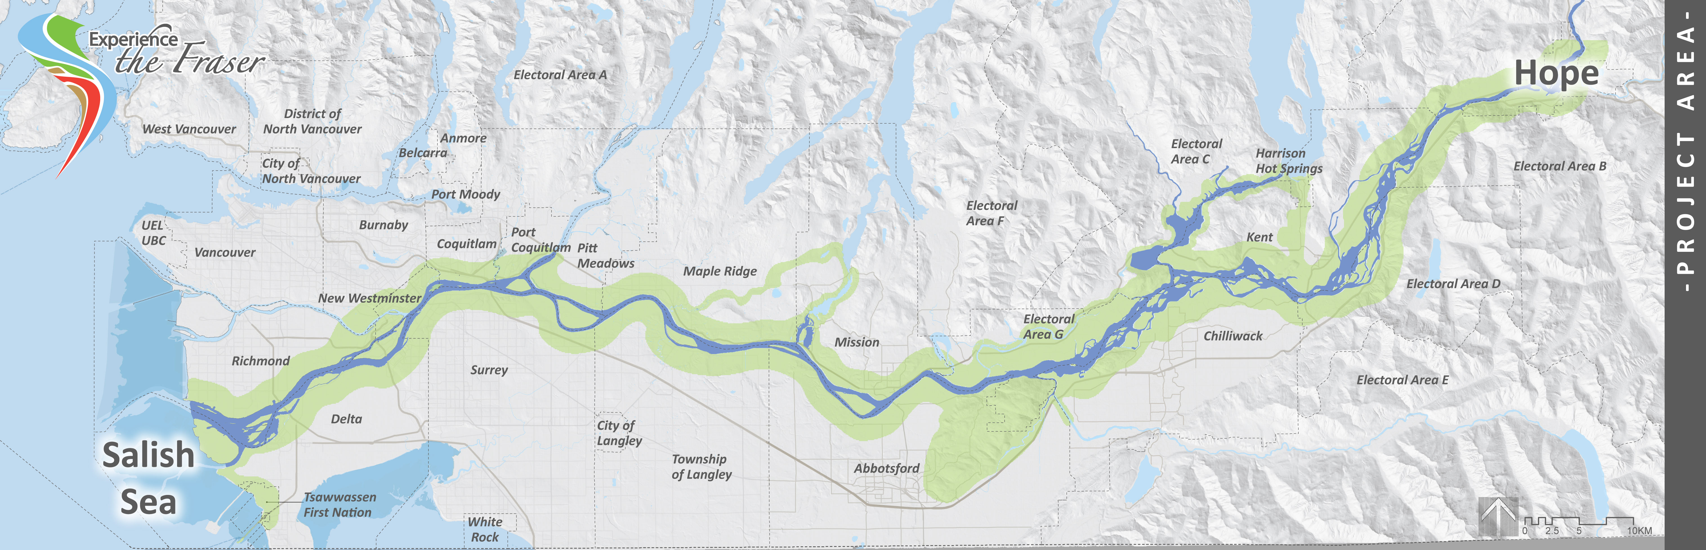
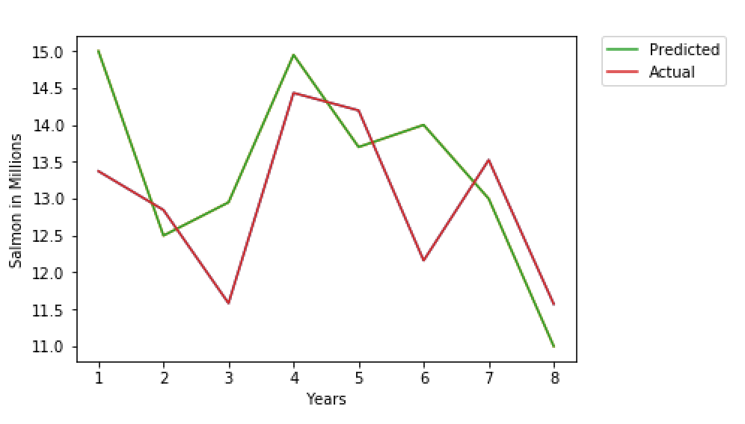
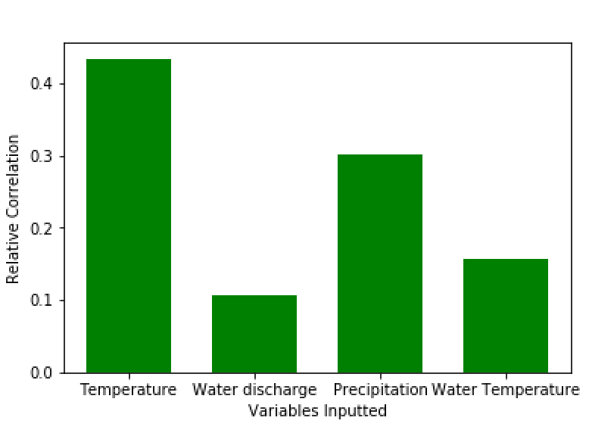
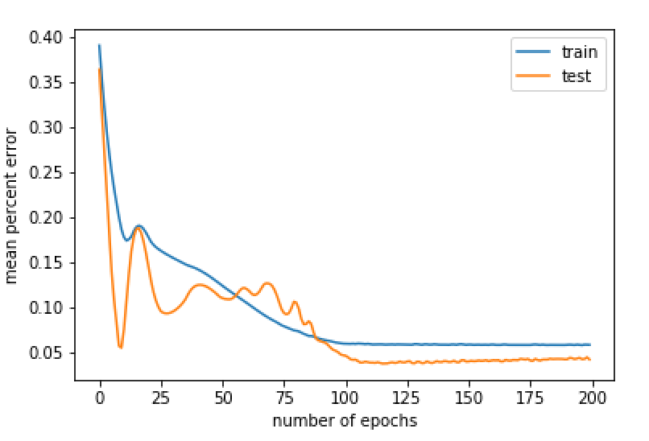
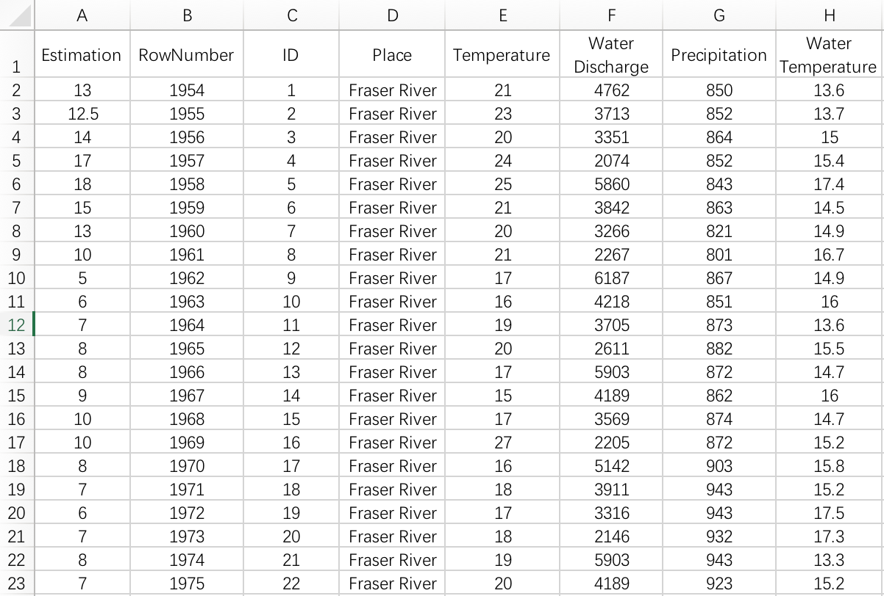
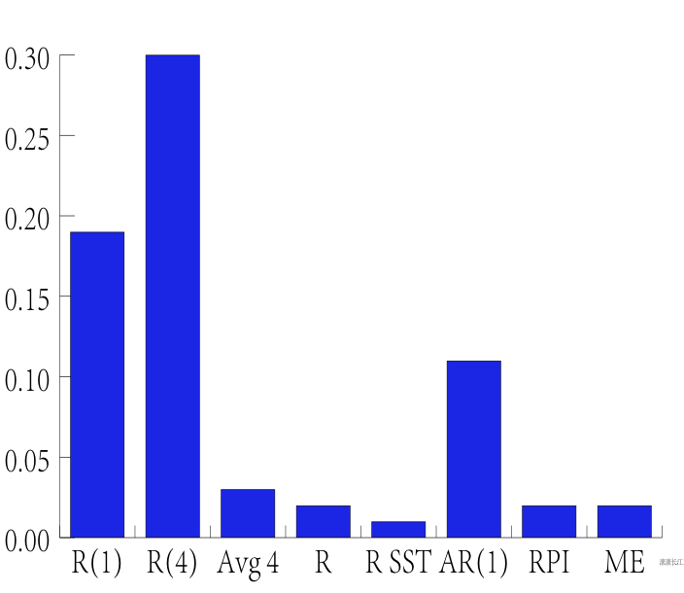
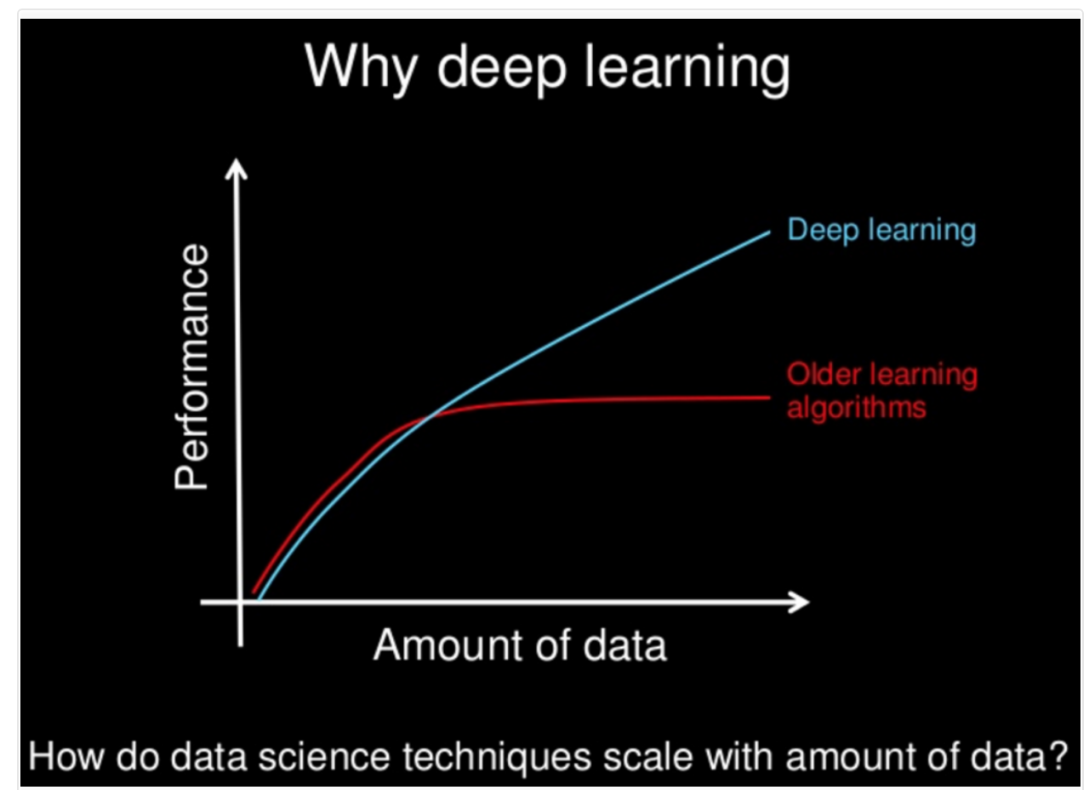
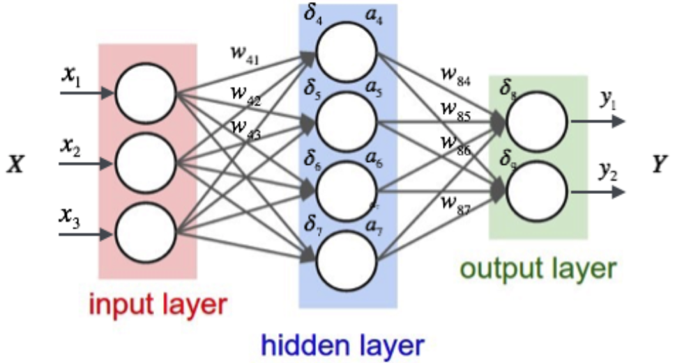
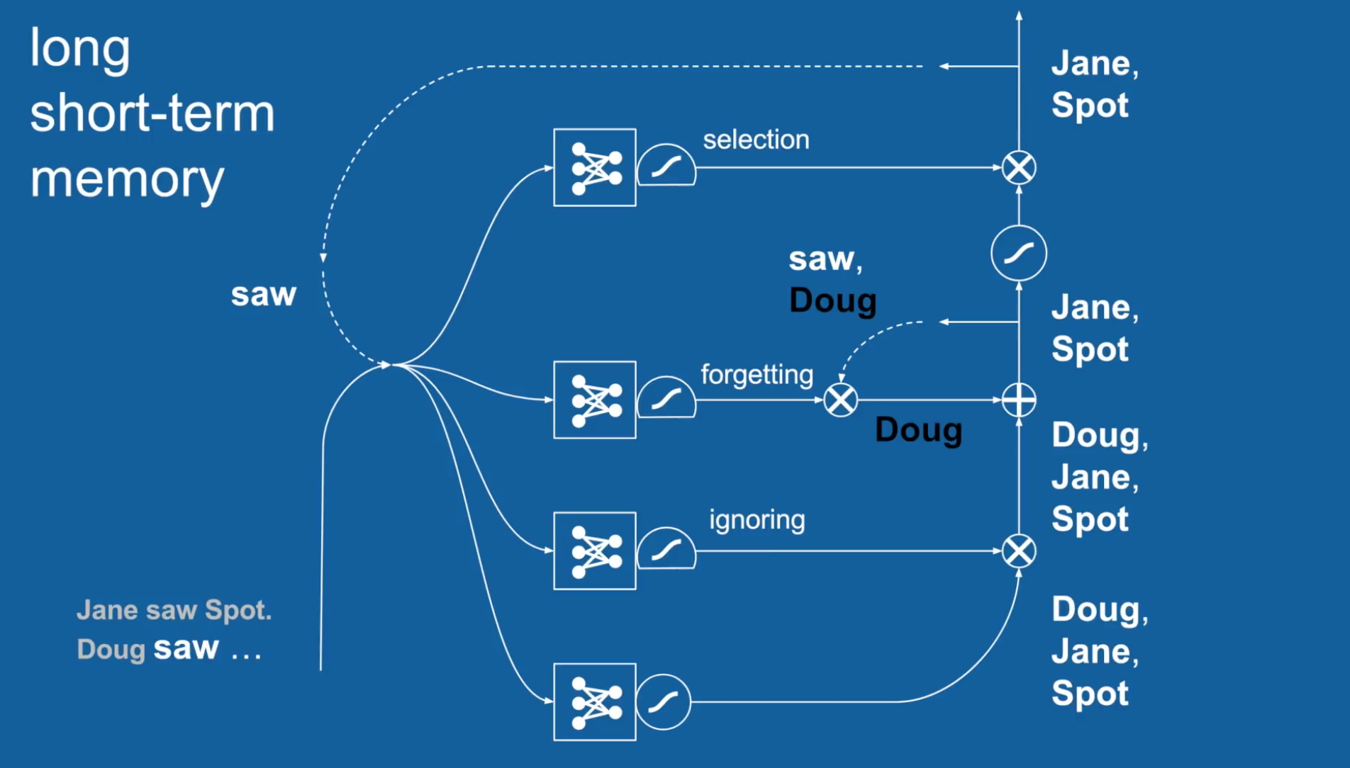
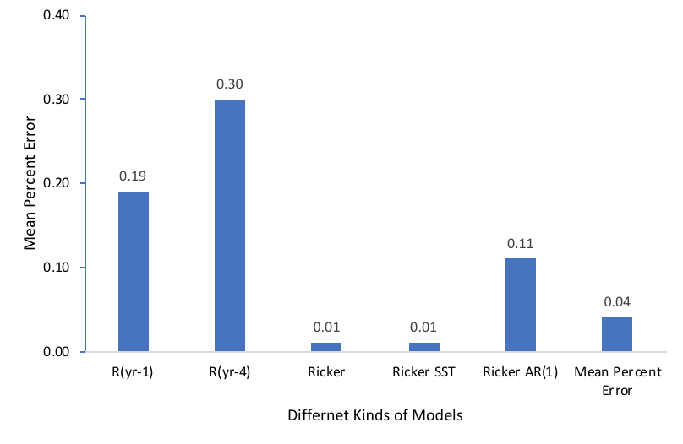
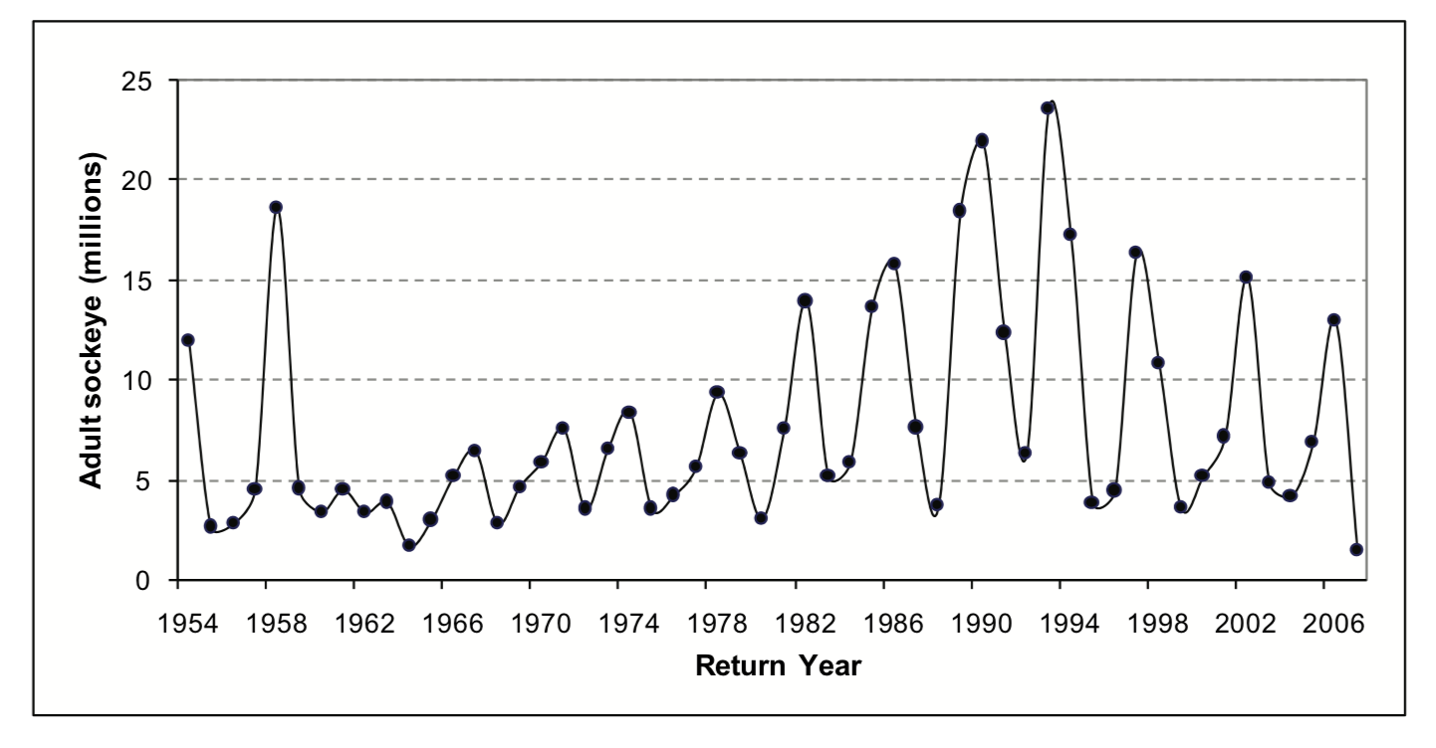
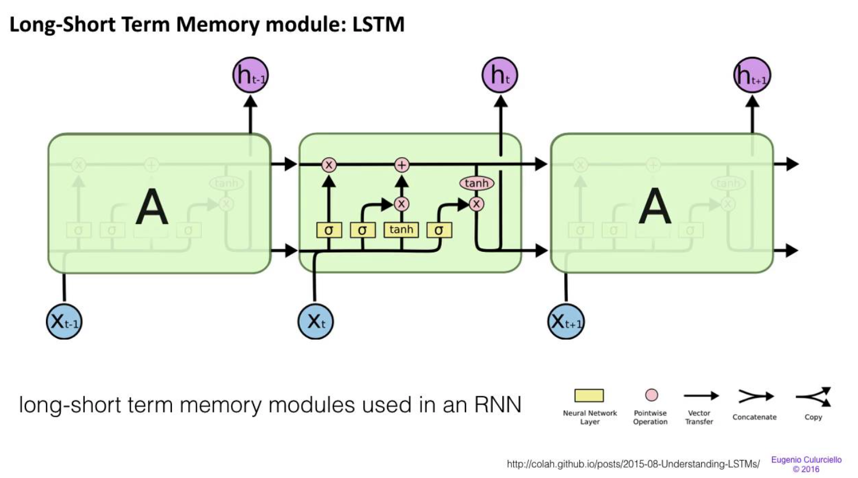

Long Short Term Memory Neural Network Software that Predicts Salmon Spawning
Thomas Yuan
Introduction
The Deep Learning Algorithm and its Performance
Results and Data Analysis
The project focusses on statistical analysis software that uses machine learning to analyze the relationship between variables and predict salmon spawning (preseason prediction).
Current market salmon prediction models have a large mean percent error rate of up to 30 percent.
Only statisticians have enough knowledge to use the current market salmon prediction models.
Out of a 4 year prediction, my prediction software has a mean percent error of only 5 percent. Out of a 10 year prediction, my software has a mean percent error of 7 percent.
Out of a 4 year prediction, the average prediction software in the market has a mean percent error of 30 percent( Ricker Model, TSD, and TSMA)
Fig. 2 Actual Salmon Number VS Predicted Salmon Number
Fig. 3 Decision Tree Feature Importance Output
Fig. 8 Performance of the Recurrent Neural Network Software Overtime
Here is how the program works
The program reads a CSV file, and the data in the file goes into the input layer.
The information is processed in the hidden neural layer of the program and is analyzed by 4 weights.
The weights of the neural network are trained with the inputted data.
The weights of the neural network make a prediction based on results from the preceding year
The weights are able to generate a prediction through a process of ignoring, forgetting, remembering, and selecting.
This system allows the algorithm to “forget” data which are too old and irrelevant, to “remember” important data in history, and to ”select” relevant data as output.
LSTM Recurrent Neural Network
Backgrounds
Selecting
The importance of Salmon (PREDICTION)
In my software, salmon spawning is considered the output of the software because many people are highly dependent upon the information. More than 137 species depend on a healthy and sustainable salmon stock. Millions of people rely on salmon as a healthy food source.
River Temperature
The Fraser River is heating up because of climate change, and an increasing number of salmon are dying in the warmer water from diseases, parasites or cardiac collapse.
Water discharge
Altering natural flows in rivers can also directly affect salmon by increasing water temperatures and causing biological stress in fish.
Temperature
Temperature could affect the salmon population to a great extent. I used the correlation coefficient feature of the software to determine any correlation between Salmon population and general temperature.
Precipitation
Rain influences salmon spawning in different ways. It could help cool down the water to temperatures salmon prefer.
Forgetting
Fig. 4 Performance of Deep Learning Algorithms Over Big Data Sets
Fig. 5 Neural Networks of the algorithm
Ignoring
Remembering
Fig. 9 Other Salmon Prediction Models
Making forecasts are crucial to managing stocks of Pacific salmon. The government sets quotas depending on the predicted salmon spawning rate. An increase in the accuracy of a salmon forecasting model would not only increase profits for fisheries but improve conservation and management.
Moreover, the area of salmon forecasting is generally exclusive to scientists. Since my software uses easily accessible CSV files, it allows people who care about the salmon population but don’t have the technical training and background to use the software for their own purposes.
The software I created not only predicts the salmon population, but also informs the user of the relative importance of the environmental factors that are inputted.
The software also evaluates its own performance and graphs the predicted salmon population. This provides valuable insight in a time-saving manner.
Fig. 1 Salmon Historical Data
Fig. 6 Long Short-Term Memory Neural Network Decision Process
Significance and Potential Applications
Fig. 7 Long Short-Term Memory Neural Network Modules
Explanation of the Used Variables (Decision Tree Feature Importance)
It is true that variables such as locally built dams, wind levels, and other variables that are not evaluated could impact salmon population. To find the variables that are most correlated to the salmon population, I did lots of research about salmon population. However, I also used a Decision Tree Feature Importance algorithm that evaluated the relationship of the variables to the salmon population and eliminated the variables that showed negligible correlations.
Acknowledgements
Marc Crompton: School teacher who encouraged me to explore the field of Machine learning and gave me valuable advice when making the software.

